Slide 1
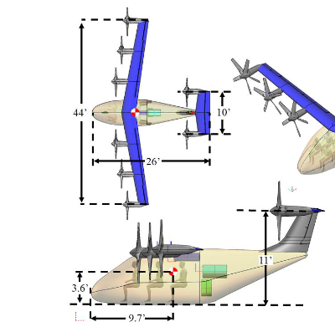
Initial Planform Assumptions
Main wing is inline with the bottom of T-Tail
Sweep angle does not appear to be specified. Will assume that this is roughly 10 degs
Front of the wing is located at coordinates [0, 0, 0]
Elastic Axis will be placed at 25% chord for all aero surfaces

Slide 2
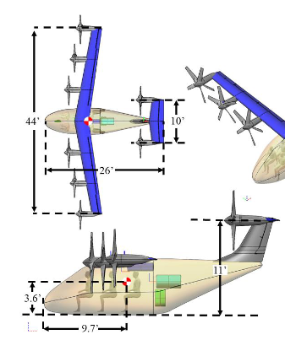
Dimensions needed for Creation
Wing
V-Tail
Span | 13.53m (semi 6.765m) – 44.4ft
Area | 11.89m² – 128ft²
Chord | .8787
Sweep | 10 deg
Span | 1.609m - 5.28 ft
Area | 1.691m² - 18.2ft²
Chord | 1.051m
Location of H-Tail is 26’ from the front of the aircraft
Assumed that cg is located at TE of root
CG is 9.7’ from nose. Chord is .8787m so distance from LE of root to TE of Tail is 5.847m
By knowing the chord dis of H-Tail, the EA is known
H-Tail
Span | 3.048m (semi 1.524m) - 10 ft
Area | 3.01m² (semi 1.505m²)– 32.4ft²
Taper | 10 deg
Root Chord | .8787

Slide 3
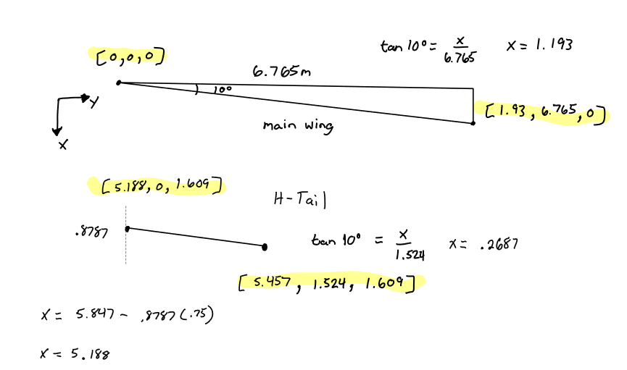
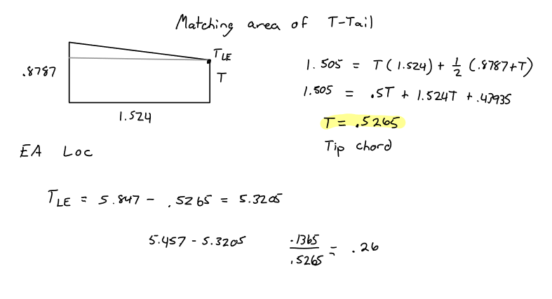
Coordinates Assuming 10 deg Sweep

Slide 4
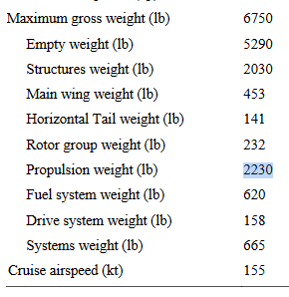
Mass Distributions
Structural Weight | 920.79 kg
Main Wing | 205.47 kg
H-Tail Weight | 63.96 kg
Rotor Group + Propulsion | 1116.74 kg
Fuel System | 281.23 kg
Drive System Weight | 71.67 kg
Systems Weight | 301.64 kg
Total Weight | 2961.5 kg
Rotor group and propulsion weight is combined. Will be divided into 8 for each rotor: 139.5925 per rotor
Adding up all mass contributions except empty weight = 6529 lbs. Will consider that the total for now

Slide 5
Structural Mass Breakdown
Structural Weight | 920.79 kg
Main Wing | 205.47 kg
H-Tail Weight | 63.96 kg
Rotor Group + Propulsion | 1116.74 kg
Fuel System | 281.23 kg
Drive System Weight | 71.67 kg
Systems Weight | 301.64 kg
Total Weight | 2961.5 kg
Main Wing: (205.47 + .40*920.79)/ (2*(6.765/cos(10))) = 35.062
T-Tail: (63.96+ .10*920.79)/ (1.609 + 2*(1.524/cos(10))) = 33.17
Fuselage Contribution: (.5*920.79)/(7.486) = 61.5
Misc. Lumped Mass to get desired CG: 654.54 kg

Slide 6
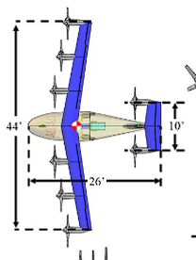

Rotor Lumped Masses
Assumed location of lumped mass is .4m forward and .3 m downward from EA locationv
[0.26, 2.315, -.3]
[1.53, 6.765, -.3]
[.895, 4.54, -.3]
[5.057, 1.525, 1.309]
Rotor group and propulsion weight is combined. Will be divided into 8 for each rotor: 139.5925 kg/rotor
2.225m distance between rotors on wings

Slide 7
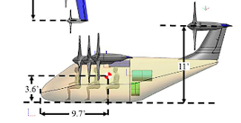
Z cg should be -.64652m
X cg should also be .659m

